Slide 1
Māori Quiz Assessment Documentation
Molly Sankey

Slide 2
Māori Quiz
Link to GitHub Repository: https://github.com/MOLLY-S1/Assessment
Links to Trello board / project management tools: https://trello.com/b/NHIDZHOy/dit-assement-maori-quiz
Link to final version of your program: https://github.com/MOLLY-S1/Assessment/commit/f2f38fd020cdef66e2f48757b8d04161ed833f98
Ensure you have made these links ‘public’ so that they are open to anyone, including the marker. The link to your program is the final outcome of this whole project – your finished program.

Slide 3
Describe relevant Implications:
Additional rows can be added by clicking in the last cell and then using the Tab key
Relevant implication | Describe the implication and give an example
Social​ | Social implications are about the affect a computer program might have on users, the wider community, and society overall. For example, programs about gambling would be negative. Use clear instructions, and inoffensive feedback.​
Future Proofing​ | Future proofing makes sure a program is flexible, adaptable, and easily modified. A programmer should be able to easily make changes, if it is well set out and commented. They should understand the purpose and reasoning behind the code. It is important to use constants rather than literals.
Notes:
Additional rows can be added by clicking in the last cell and then using the Tab key

Slide 4
Describe relevant Implications:
Additional rows can be added by clicking in the last cell and then using the Tab key
Relevant implication | Describe the implication and give an example
Functionality​ | Functionality makes sure the program runs as its supposed to. It should work for all cases including boundary, expected, and unexpected. ​
Usability​ | Usability is how easy the program is to use. Instructions and error messages should be easily understood. Make sure the user does not feel frustrated.​
Aesthetics​ | Aesthetics is how the program looks, and its appearance. An aesthetically pleasing program will contain well spaced instructions, prompts and decorations around key messages.​
Notes:
Additional rows can be added by clicking in the last cell and then using the Tab key

Slide 5
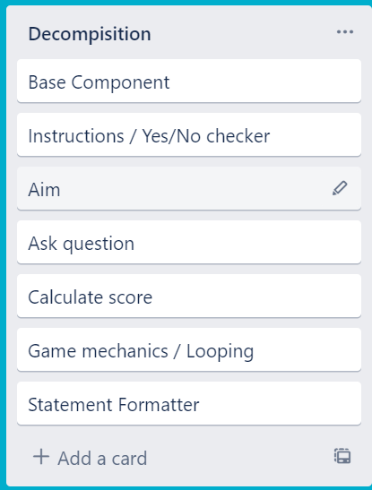
Decomposition:
Notes:
Paste screenshots of your initial Trello board / task decomposition on this slide. If you have a long list, you might need to break it up into several slides.

Slide 6
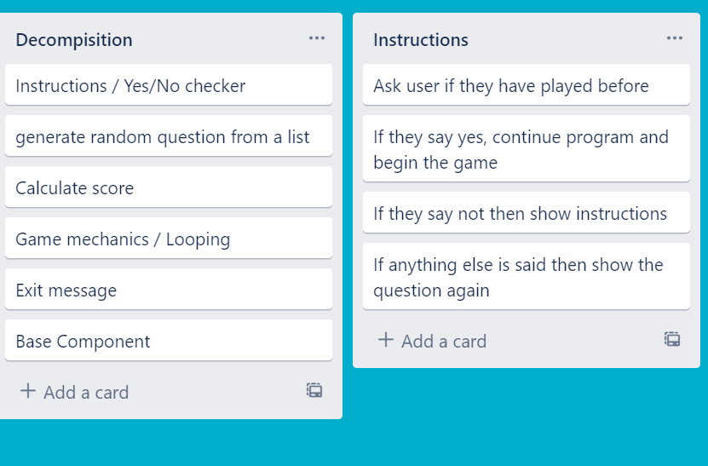
Component 1 (instructions and Yes/No checker)

Slide 7
Instructions - Test Plan
Additional rows can be added by clicking in the last cell and then using the Tab key
Test Cases - input | Expected output
Yes | Program continues
Y | Program continues
No | Program continues
N | Program continues
yes | Program continues
Maybe | Please enter either “Yes” or “No”
Notes:
Additional rows can be added by clicking in the last cell and then using the Tab key

Slide 8
Instructions - Test Plan
Test Cases - input | Expected output
Have you played this quiz before? Maybe | <error> Please choose y/n
Have you played this quiz before? Yes | Quiz starts
Have you played this quiz before? No | Show instructions, then begin the quiz
Notes:
Additional rows can be added by clicking in the last cell and then using the Tab key

Slide 9
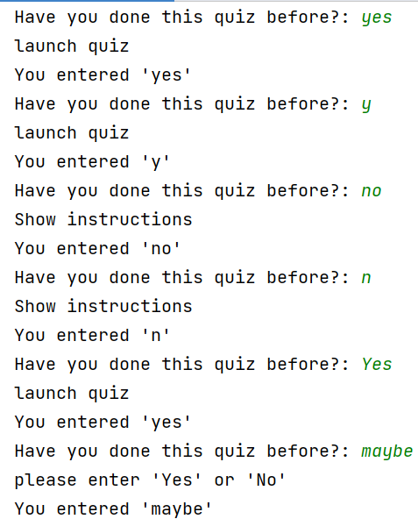
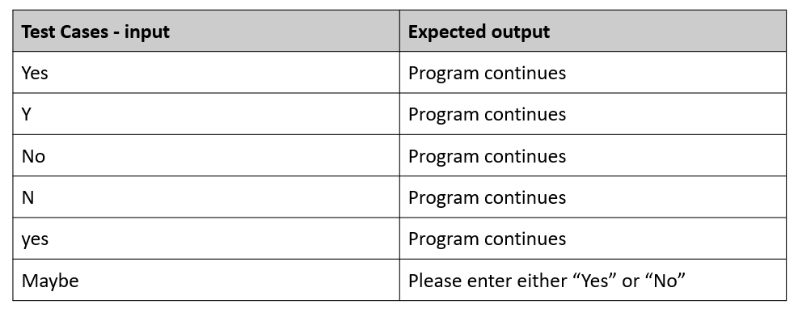



Instructions – Test Results
All test cases worked as shown

Slide 10
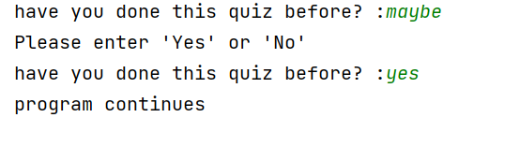
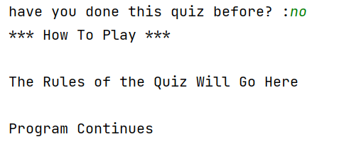


Instructions (with Yes/No checker): Testing
Test Cases - input | Expected output
Have you played before? Maybe | <error> Please choose y/n
Have you played before? Yes | Game starts
Have you played before? No | Show instructions, then start the game
All test cases worked as expected
Notes:
NOTE: Trialling needs to happen for at least 2 of your components but is not necessary for ALL components.
Trialling is not the same as testing. Trialling is about finding different ways of building the same component. Show evidence of your trialling here. Select one of your trials for further development and give reasons for your choice.

Slide 11
Instructions: Development
Trial 1 01_Instructions_V1 | This program ran as expected but did not allow for the input of single letters (‘y’ or ‘n’). It was also case sensitive, meaning that all first letters must be entered in uppercase for a valid statement.
Trial 2 01_Instruction_V2 | Program now allows user to enter response in any cases. It also allows the user to enter ‘y’ or ‘n’ as a response to the question. The code also prints your input at the end of the program.
Trial 3 01_Instructions_V3 | Program is now in a loop to make testing easier.
Trial 01 01_Instructions_V4 | Program made from version 3 but is now in a function so that it is easy recycle for other Yes/No questions that may be incorporated in the program. This will be apart of my finished program.
Notes:
NOTE: Trialling needs to happen for at least 2 of your components but is not necessary for ALL components.
Trialling is not the same as testing. Trialling is about finding different ways of building the same component. Show evidence of your trialling here. Select one of your trials for further development and give reasons for your choice.

Slide 12
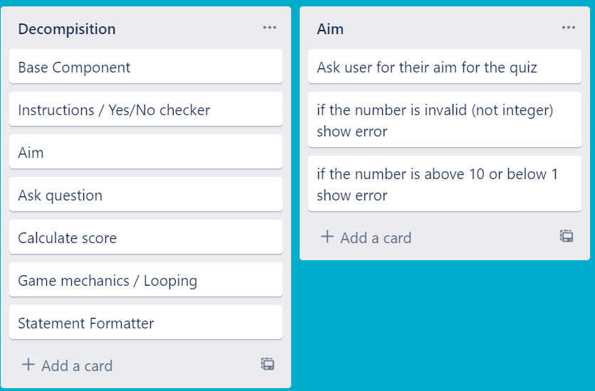
Component 2 – Aim

Slide 13
Aim - Test Plan
Test Cases - input | Expected output
Xxxi (invalid – string) | Error – please enter a whole number between 1 and 10
O.5 (invalid – float) | Error – please enter a whole number between 1 and 10
0 (invalid – below lower boundary) | Error – please enter a whole number between 1 and 10
11 (invalid – above upper boundary) | Error – please enter a whole number between 1 and 10
1 (valid – lower boundary) | Program continues
10 (valid – upper boundary) | Program continues
Notes:
Additional rows can be added by clicking in the last cell and then using the Tab key

Slide 14
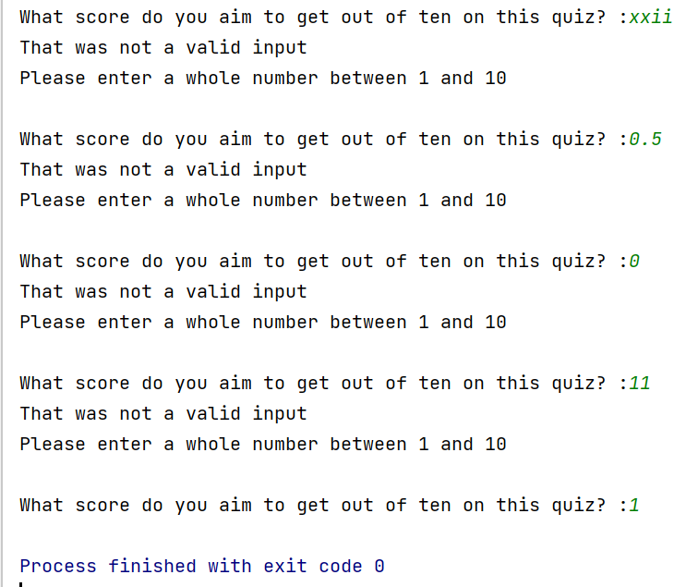
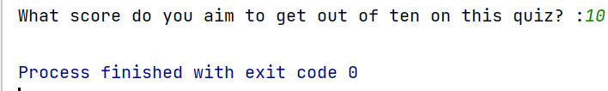
Aim - Testing
All tests passed
Program works for unexpected and expected cases and boundary cases

Slide 15
Aim: Development
Trial 1 08_Aim_V1 | The program works but only if integers are entered. Any cases that are outside of integer range are correctly refused but the program will crash when floats and strings are entered.
Trial 2 08_Aim_V2 | The program allows for strings, floats and integers but could be more efficient
Trial 3 08_Aim_V3 | The basis of the program is now a while loop, so it is adaptable and more efficient
Trial 01 08_Aim_V4 | Program made from trial 3 but is now in a function and can be recycled for other components
Notes:
NOTE: Trialling needs to happen for at least 2 of your components but is not necessary for ALL components.
Trialling is not the same as testing. Trialling is about finding different ways of building the same component. Show evidence of your trialling here. Select one of your trials for further development and give reasons for your choice.

Slide 16
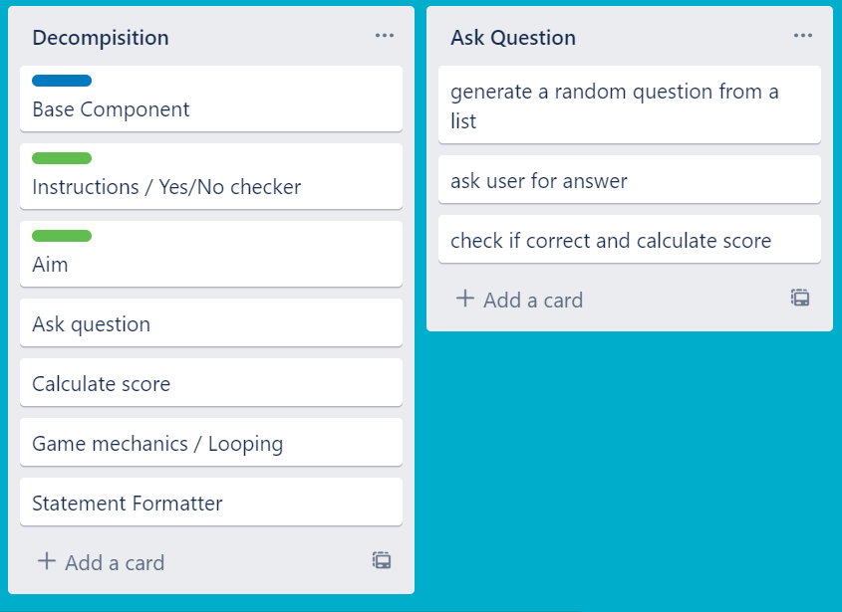
Component 3 – Question Generator

Slide 17
Question Generator - Test Plan
Test Cases - input | Expected output
1 | Correct
One (correct in written form) | Correct
Xxi (incorrect answer) | Incorrect “The answer was {}”
0.4 (incorrect answer) | Incorrect “The answer was {}”
The program accepts all cases, expected and unexpected
Notes:
Additional rows can be added by clicking in the last cell and then using the Tab key

Slide 18
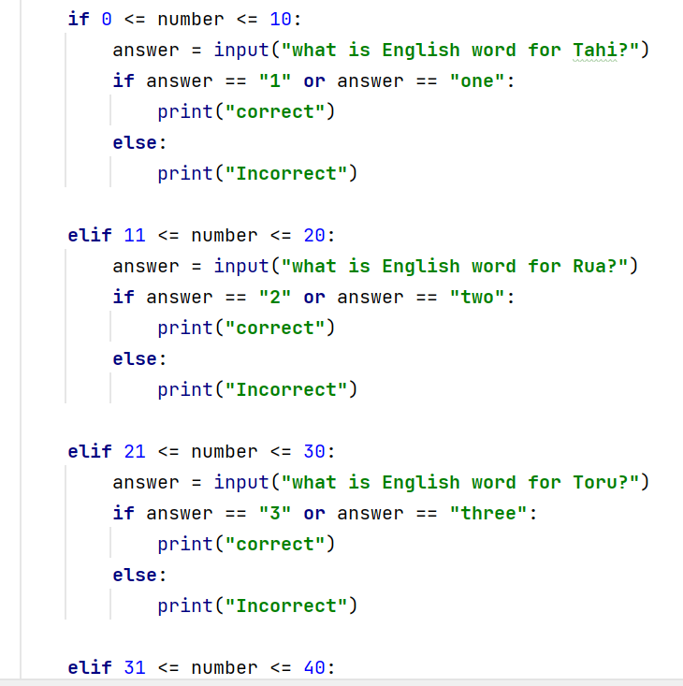

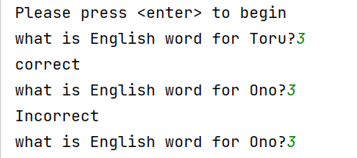
Question Generator – Trialling Part 1
In this version of the code the question a random number and is determined by if, elif statements dependent on what number they correspond to. Because of this the code will repeat itself, asking the same question multiple times .
This code is also very bulky and harder to adapt or recycle later
Output

Slide 19
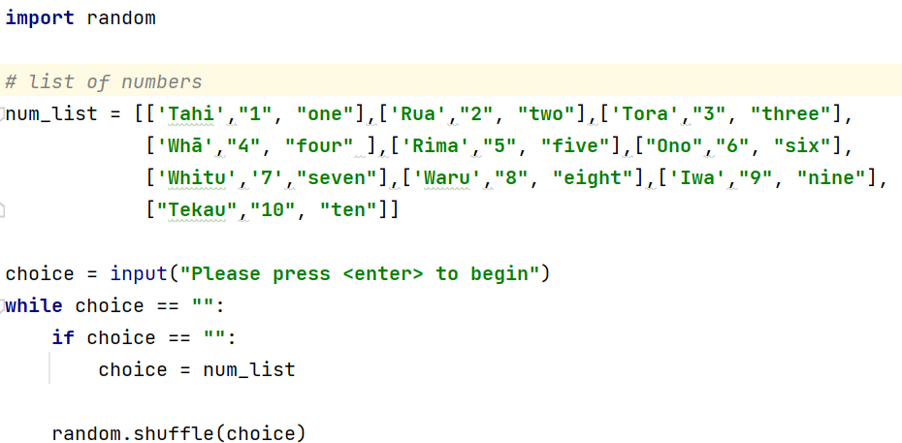
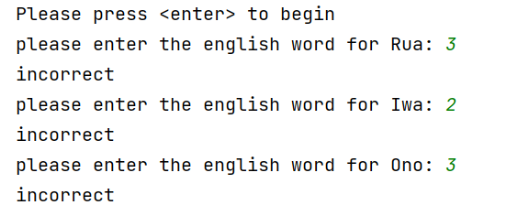
Question Generator – Trialling Part 2
In this version of the code the question is determined by a list of numbers being shuffled. This means that it will never pick the same question more than once and is easily adaptable in the future. It is also less bulky than the other code and this is why I have chosen this as my final component’s code.
Output

Slide 20
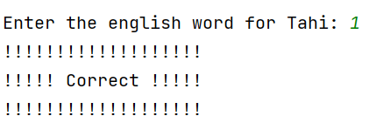
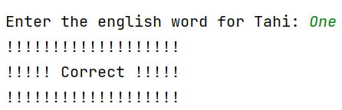
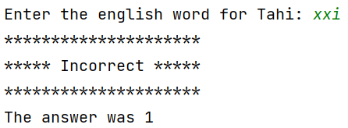
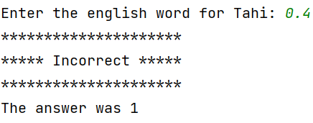



Question Generator - Testing
Test Cases - input | Expected output
1 | Correct
One (correct in written form) | Correct
Xxi (incorrect answer) | Incorrect “The answer was {}”
0.4 (incorrect answer) | Incorrect “The answer was {}”

Slide 21
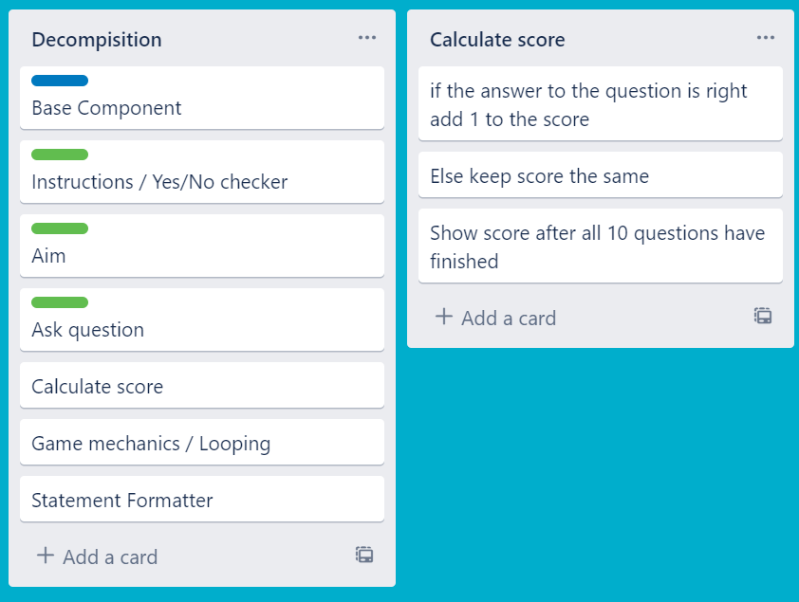
Component 4 – Score Calculator

Slide 22
Score calculator- Test Plan
Test Cases - input | Expected output
User answers correct | Add one point to score
User answers wrong | Score stays the same
Notes:
Additional rows can be added by clicking in the last cell and then using the Tab key

Slide 23
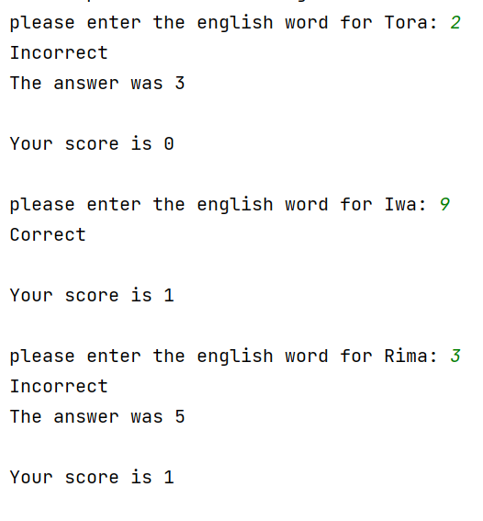
Score Calculator - Testing
Nothing is added to the score when the answer is incorrect and 1 is added to the score when the answer is correct

Slide 24
Question Generator / Score Calculator :Development
Trial 1 04_Question_V1 | The program generates a random question from the list for the user to answer. The program works but only allows integers to be entered.
Trial 2 04_Question_V2 | The program now allows all types of answers (floats, strings and integers) and will accept the English word for numbers as well as the numbers themselves. It is also no longer case sensitive by using a .lower statement.
Trial 3 04_Question_V3 | The program now incorporates the score calculator component and gives feedback to the user on their wrong answers.
Trial 4 04_Question_V4 | This program is the same as V3 but has been put in a loop for ease of testing.
Trial 01 04_Question_V5 | Program made from trial 3 as it has the simplest code, but is now in a function and can be recycled for other components
Notes:
NOTE: Trialling needs to happen for at least 2 of your components but is not necessary for ALL components.
Trialling is not the same as testing. Trialling is about finding different ways of building the same component. Show evidence of your trialling here. Select one of your trials for further development and give reasons for your choice.

Slide 25
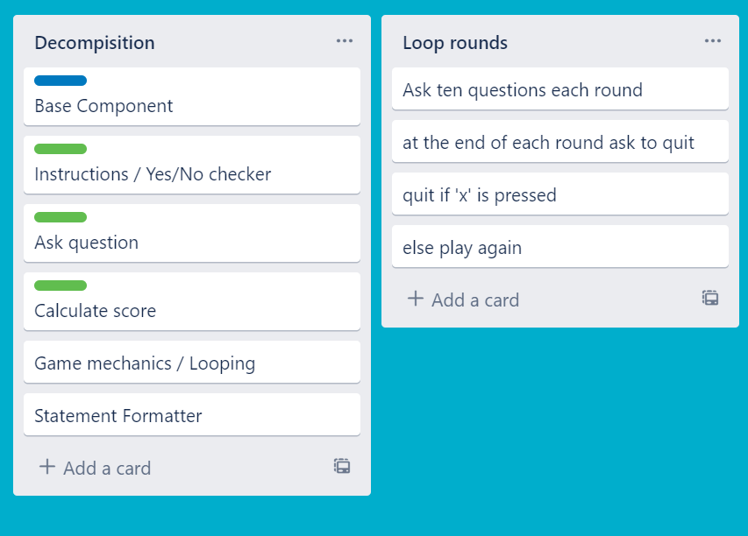
Component 5: Game Mechanics and Looping

Slide 26
Mechanics and Looping - Test Plan
Test Cases - input | Expected output
at the end of a set of ten questions the user enters ‘x’ to quit | The users score and feedback will have been shown already and the exit screen will run
At the end of a set of ten questions the user enters <enter> to play another round | New round will begin without the instructions being shown first
Notes:
Additional rows can be added by clicking in the last cell and then using the Tab key

Slide 27
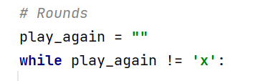
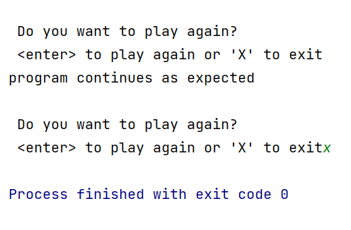
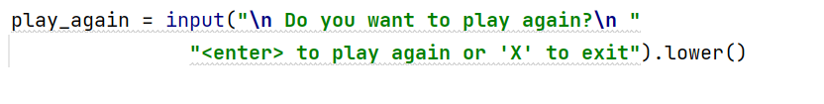
Looping and Game Mechanics –Trialling Part 1
V1 Code
V1 Output
This code is easy to run as it has few components and is based off a while loop. This means that it will continue looping until ‘x’ is pressed. Because of these reasons I have chosen to use this code in my final program.
Notes:
Additional rows can be added by clicking in the last cell and then using the Tab key

Slide 28
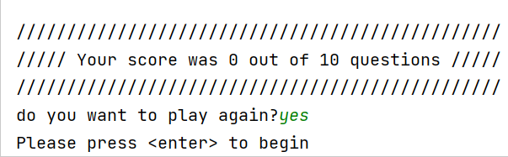
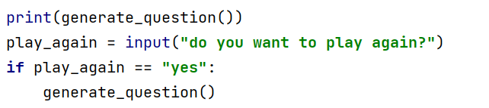
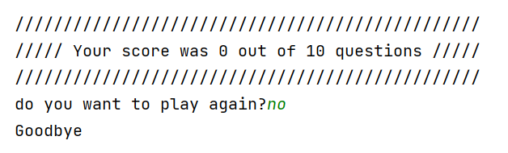
Looping and Game Mechanics –Trialling Part 2
V2 Code
V2 Output
This code uses less code to run and is also easily adaptable. But because the code is not based off a while loop it will only have the option to run for 2 rounds. This is why this code has not been chosen.
Notes:
Additional rows can be added by clicking in the last cell and then using the Tab key

Slide 29
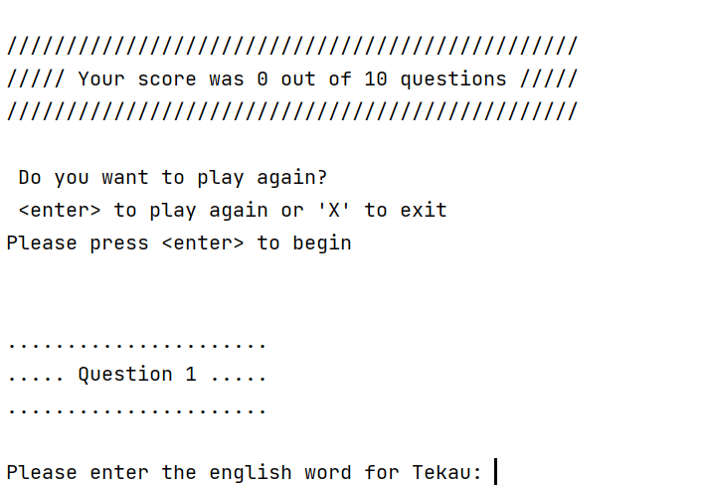
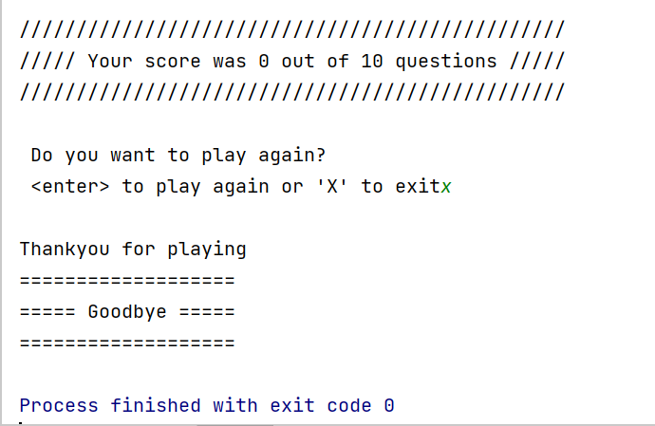
Looping and Game Mechanics - Testing
V2 Code
Code continues when <enter> is pushed when the round finishes
Code finishes when x is pushed when the round finishes
Notes:
Additional rows can be added by clicking in the last cell and then using the Tab key

Slide 30
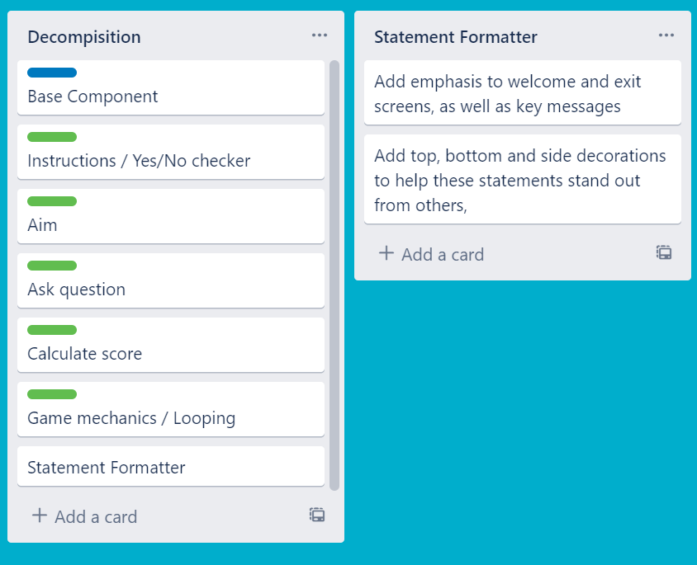
Component 6 - Statement Formatter
The output often has to standout from other statements, and we can do this by creating a function.

Slide 31
Statement Formatter Test Plan
Test Cases - input | Expected output
Statement 1 “Welcome to the Māori Quiz” Decoration “-” | ------------------------------------------------------------- Welcome to the Māori Quiz! -------------------------------------------------------------
Statement 2 “Correct” Decoration ”!” | !!!!!!!!!!!!!!!!!!!!!!!! !!!!!! CORRECT !!!!! !!!!!!!!!!!!!!!!!!!!!!!!
Statement 3 “Incorrect” Decoration “*” | ******************** ***** INCORRECT ***** ********************
Statement 4 “Goodbye” Decoration ==== | ==================================================== Goodbye ============= =====================================
Notes:
Additional rows can be added by clicking in the last cell and then using the Tab key

Slide 32
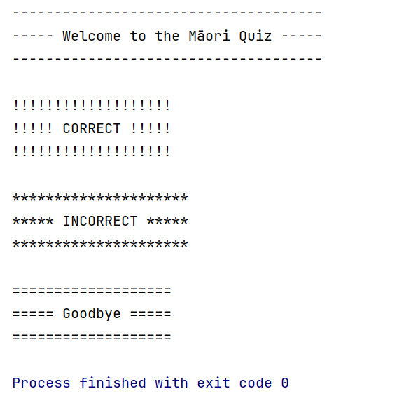
Statement Formatter - Testing
Statement formatter function worked as expected
Notes:
Additional rows can be added by clicking in the last cell and then using the Tab key

Slide 33
Test Plan: Assembled outcome – Part 1
Test Cases - input | Expected output
Run Program Played before = maybe Played before = no | Welcome message displays Error, please answer yes or no Show instructions
Run program Played before = yes | Start quiz
Enter amount to play with Xiii o.5 0 11 1 | Error Error Error Error Press <enter> to start
Notes:
Additional rows can be added by clicking in the last cell and then using the Tab key

Slide 34
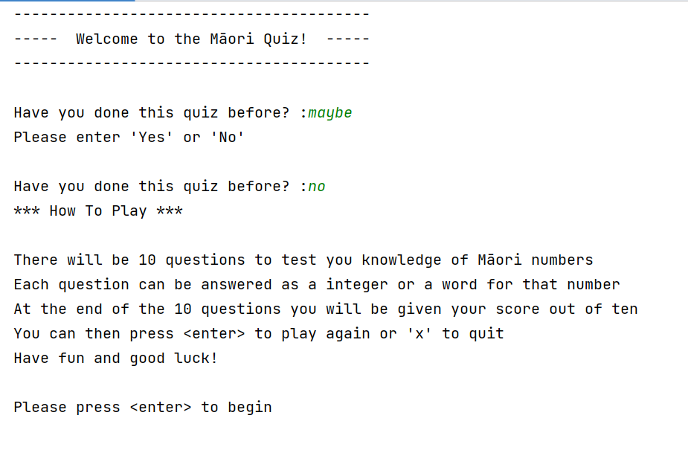
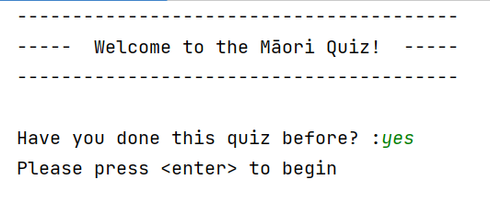
Assembled Outcome Testing: 1
All results worked as expected
Notes:
Show testing for your assembled outcome below. This should include a test plan followed by screenshot proof.

Slide 35
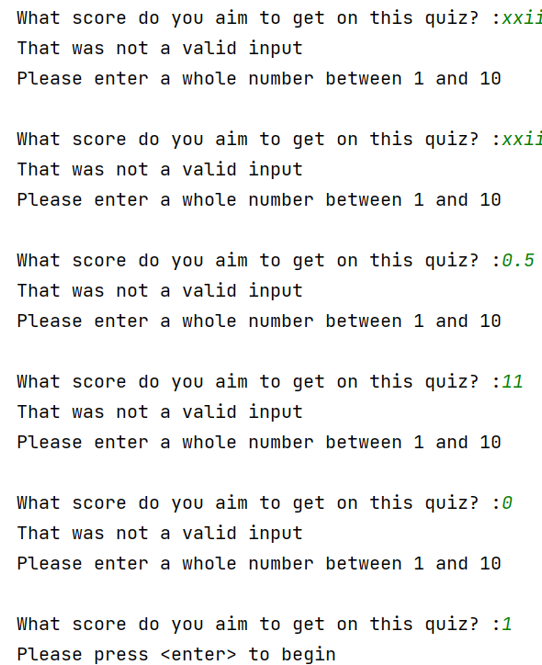
Assembled Outcome Testing: 1 (part 2)
All results worked as expected
Notes:
Show testing for your assembled outcome below. This should include a test plan followed by screenshot proof.

Slide 36
Test Plan: Assembled outcome – Part 2
Test Cases - input | Expected output
User answers every question wrong | For each question: Print – “incorrect” “The answer was {}” At the end: Show score of 0/10 Print – “You should probably do some more studying!”
User answers every question correct | For each question: Print – “Correct” At the end: Show score of 10/10 Print – “10/10 THAT'S AMAZING!!!”
Notes:
Additional rows can be added by clicking in the last cell and then using the Tab key

Slide 37
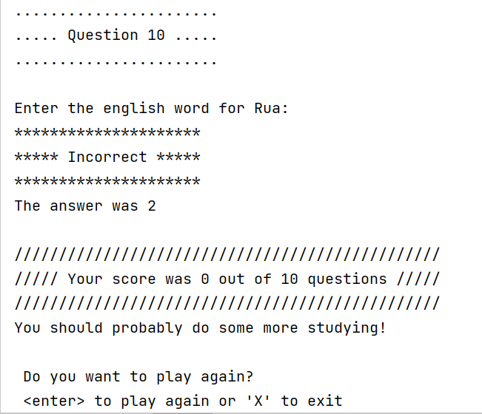
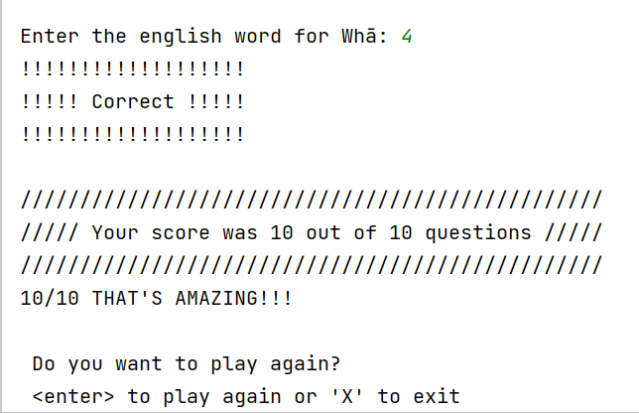
Assembled Outcome Testing: 2
ALL INCORRECT
ALL CORRECT
All Results worked as expected
Notes:
Show testing for your assembled outcome below. This should include a test plan followed by screenshot proof.

Slide 38
Test Plan: Assembled outcome – Part 3
Test Cases - input | Expected output
Quiz ends User presses <enter> to play again | Questions reset to 1 Quiz continues
Quiz ends User presses ‘x’ to finish | Show farewell screen
Notes:
Additional rows can be added by clicking in the last cell and then using the Tab key

Slide 39
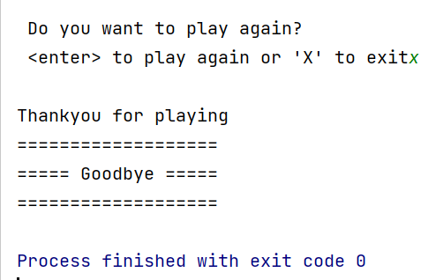
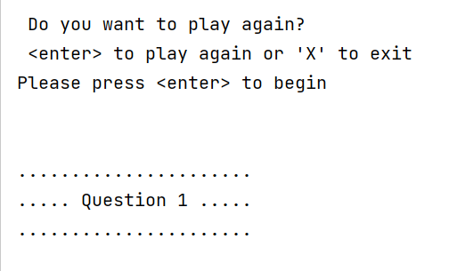
Assembled Outcome Testing: 3
PLAY AGAIN
DO NOT PLAY AGAIN
All Results worked as expected
Notes:
Show testing for your assembled outcome below. This should include a test plan followed by screenshot proof.

Slide 40
Address relevant Implications:
Relevant implication | Explain how your final outcome addresses each implication
Functionality | I have comprehensively tested my final project to ensure the functionality has been addressed. This means that it will allow expected and unexpected cases.
Usability | The inclusion of error messages and instructions throughout this program have been used, ensuring that the outcome is easy to use.
Aesthetics | The program has a carefully spaced output and used a statement formatter to enhance the appearance. Although aesthetics is not the main focus of text-based programs it helps by addressing the usability implication as it adds emphasis to important statements.
Social | All Māori words are spelt correctly (with macrons when needed) this addresses the issue of social implications.
Future proofing | I avoided the use of literals and used functions to make my code flexible and adaptable for the future. It is also well documented so that a programmer in the future will know what each piece of code does.

Slide 41
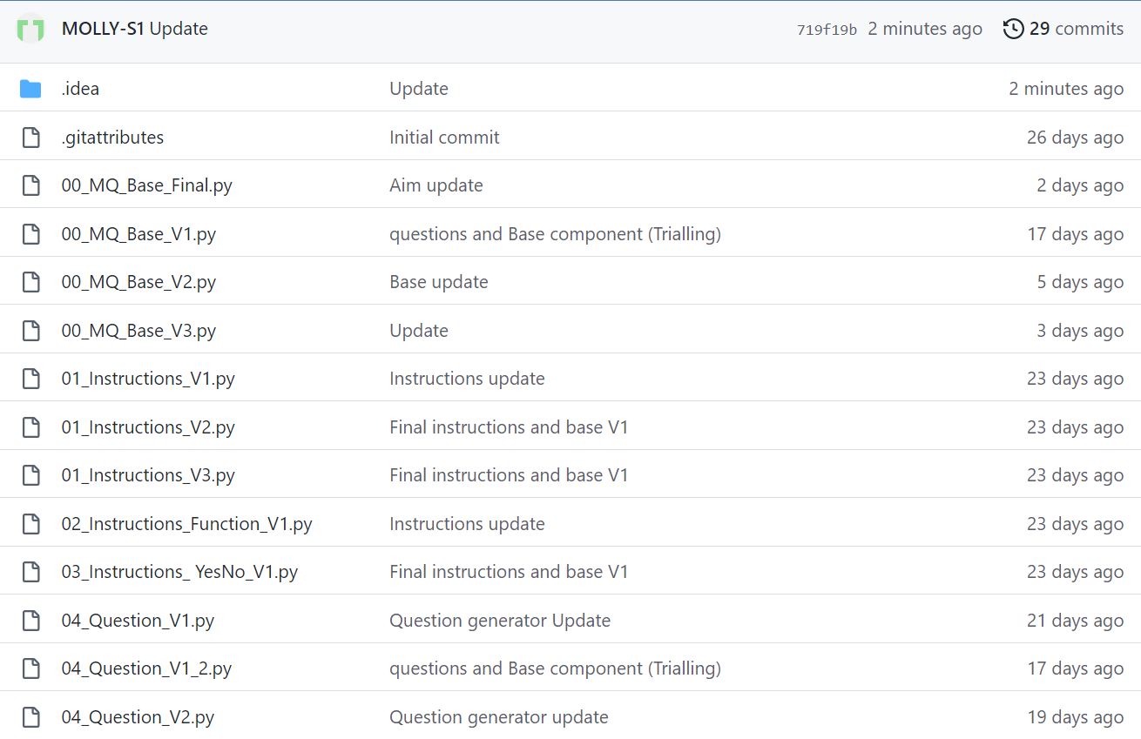
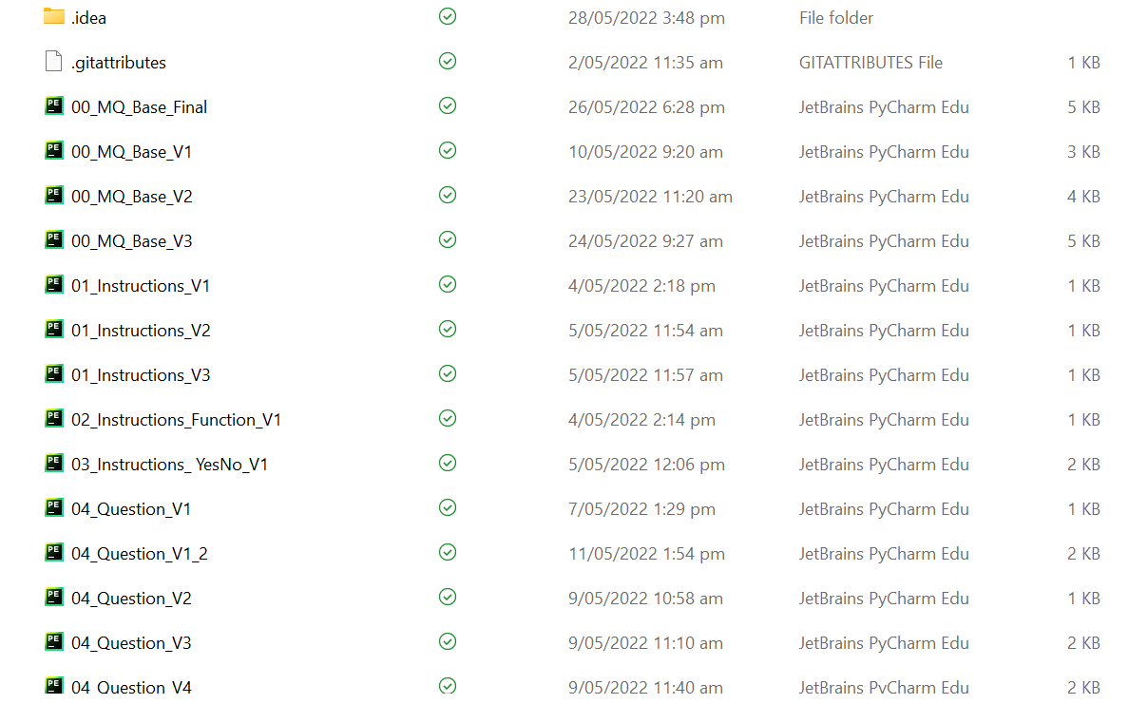
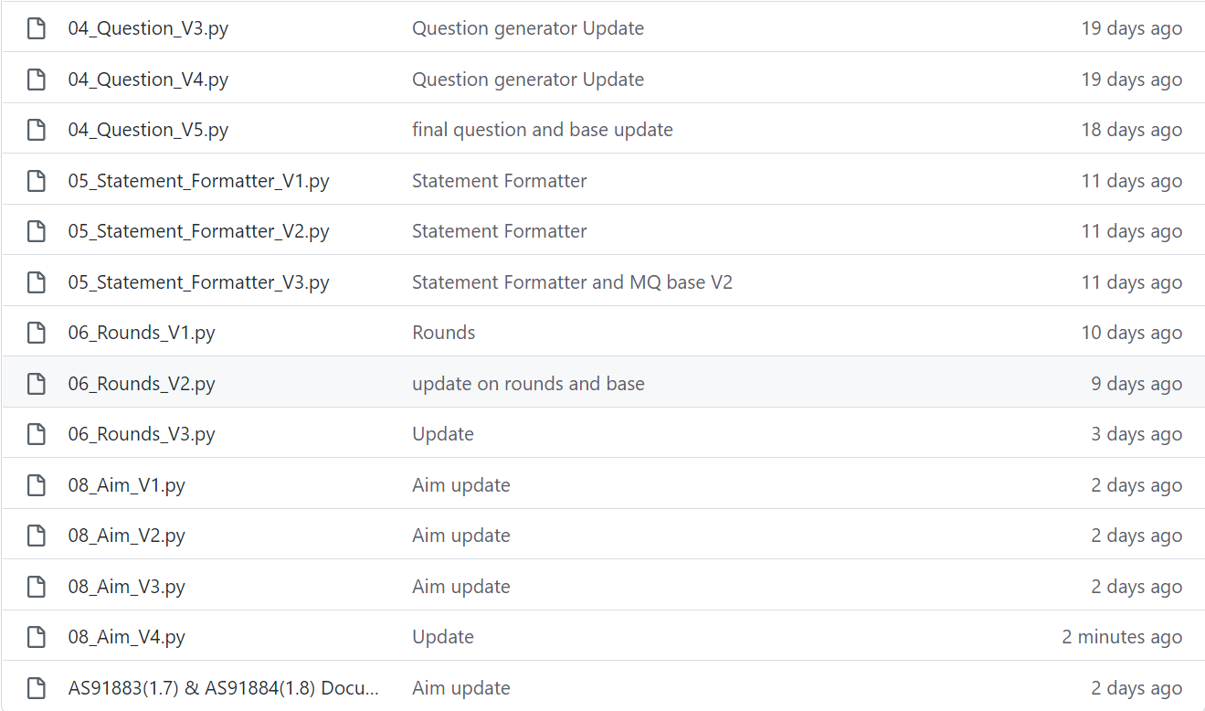
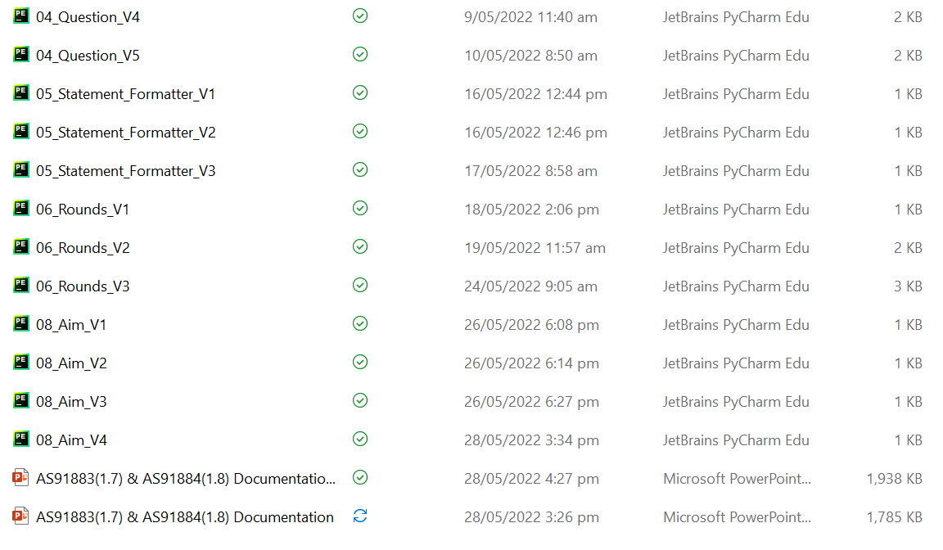
Version Control Evidence:
Notes:
Your version control evidence should go here. This could be in the form of screenshots (both of your GitHub repository as well as your local project folder) as evidence of your incremental development.

Slide 42
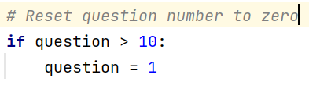
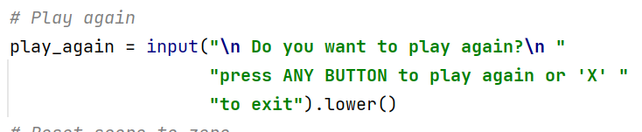
End User Testing
When talking with users about my final problems there was a few problems found:
The questions did not reset from 0 when a new round was played. I have now fixed this by adding two lines of code:
When a new round is wanting to be played the code previously stated that “press <enter> to play again but if any thing except ‘x’ will play another round. This has now been changed to show that any key can be entered to play again:
Notes:
Your version control evidence should go here. This could be in the form of screenshots (both of your GitHub repository as well as your local project folder) as evidence of your incremental development.

Slide 43
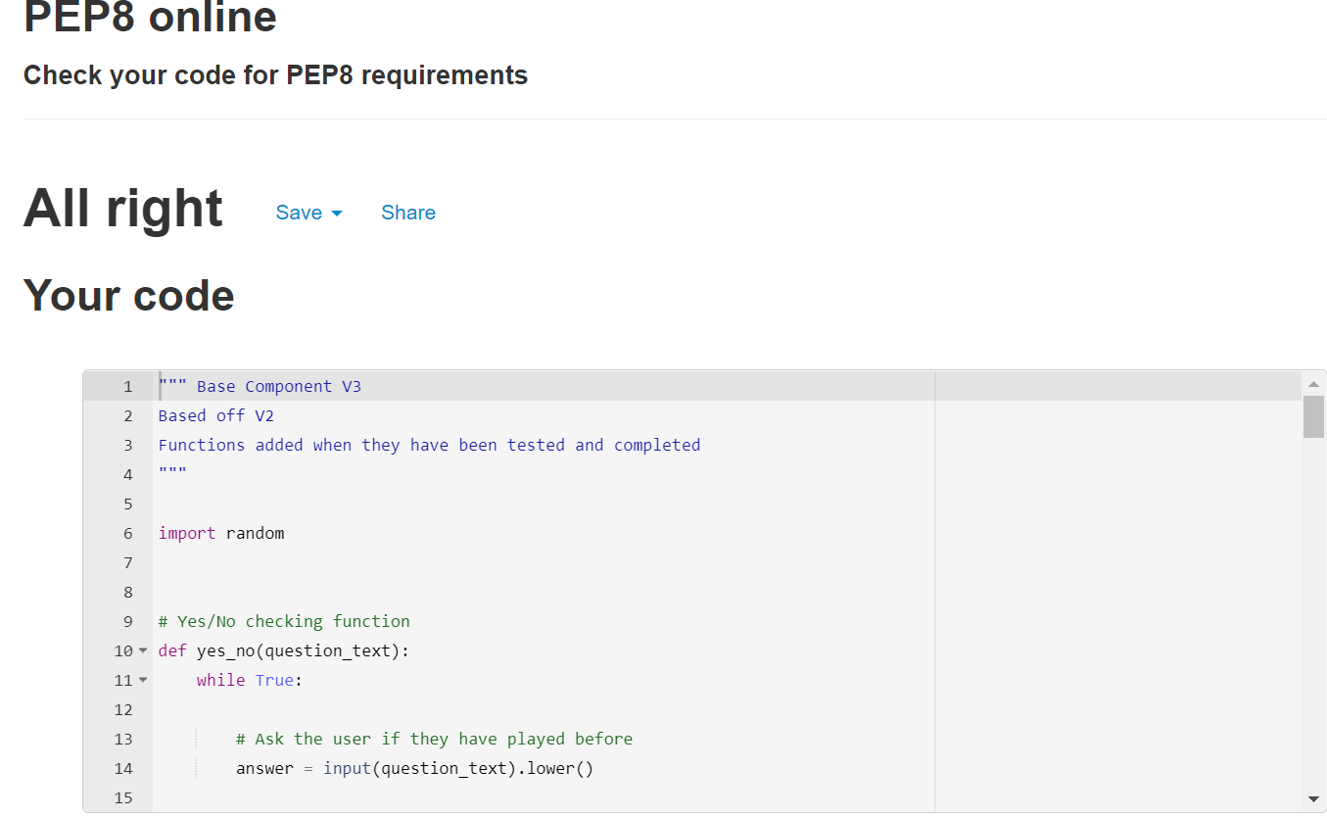
PP8 Check:
Notes:
Discuss how the information from planning, testing and trialling of components assisted in the development of a high-quality outcome.

Slide 44
Final Discussion:
Throughout making this code I have tested and trialed every component as a standalone function/piece of code and as a full program
By decomposing the problem, I was able to focus on creating each chunk of code on its own and testing to make sure that it was finished before I began the next. Each of these smaller chunks were thoroughly tested before being added to the base component.
Through testing I have been able to find and fix any flaws in my code before they were combined into a full program.
Through having other people (not in this class) test my program I was able to find out how to improve its functionality and gain ideas on how to make it more user friendly. This improved the quality of my finished program.
I have also applied all relevant implications that I stated to my code. This makes the code a higher quality and more user friendly
By making a large program smaller by using functions I have been able to code my program more efficient overall.
I have tested my code using the PP8 checker to make sure it met the conventions regarding space and layout.
Notes:
Discuss how the information from planning, testing and trialling of components assisted in the development of a high-quality outcome.

